Slide 1
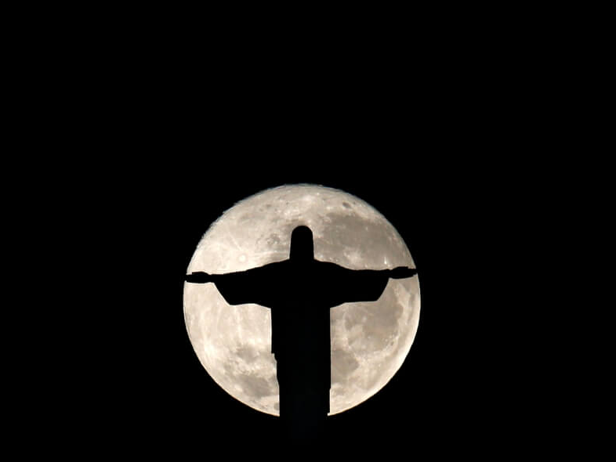
Hope praises God’s plan for the Person.
Ruth 4.18-22
&
Matthew 21.6-11

Slide 2

The bright Hope of the promised Messiah is God’s plan to redeem and restore people into right relationship with God.

Slide 3
The Messiah is the Son of David, Savior and King.
God is Faithful & Good —
God has a plan for people and will accomplish it
God’s plan is for the good of the person
He redeems and restores
God is Patient & Loving… preparing for Jesus to be God’s King

Slide 4
Matthew 1.1-17
The record of the genealogy of Jesus the Messiah, the son of David, the son of Abraham:
2 Abraham was the father of Isaac, Isaac the father of Jacob, and Jacob the father of Judah and his brothers.

Slide 5
Matthew 1.1-17
3 Judah was the father of Perez and Zerah by Tamar, Perez was the father of Hezron,
and Hezron the father of Ram.
4 Ram was the father of Amminadab,
Amminadab the father of Nahshon,
and Nahshon the father of Salmon.
5 Salmon was the father of Boaz by Rahab,
Boaz was the father of Obed by Ruth,
and Obed the father of Jesse.
6 Jesse was the father of David the king.
David was the father of Solomon by Bathsheba who had been the wife of Uriah.

Slide 6
Matthew 1.1-17
16 Jacob was the father of Joseph the husband of Mary, by whom Jesus was born, who is called the Messiah.
17 So all the generations from Abraham to David are fourteen generations; from David to the deportation to Babylon, fourteen generations; and from the deportation to Babylon to the Messiah, fourteen generations.

Slide 7
2 Samuel 7.12-16
12 “When your days are complete and you lie down with your fathers, I will raise up your descendant after you, who will come forth from you, and I will establish his kingdom. 13 “He shall build a house for My name, and I will establish the throne of his kingdom forever. 14 “I will be a father to him and he will be a son to Me; when he commits iniquity, I will correct him with the rod of men and the strokes of the sons of men, 15 but My lovingkindness shall not depart from him, as I took it away from Saul, whom I removed from before you. 16 “Your house and your kingdom shall endure before Me forever; your throne shall be established forever.”’”

Slide 8
Matthew 21.6-11
6 The disciples went and did just as Jesus had instructed them, 7 and brought the donkey and the colt, and laid their coats on them; and He sat on the coats. 8 Most of the crowd spread their coats in the road, and others were cutting branches from the trees and spreading them in the road.
9 The crowds going ahead of Him, and those who followed, were shouting,
“Hosanna to the Son of David;
BLESSED IS HE WHO COMES IN THE NAME OF THE LORD;
Hosanna in the highest!”
10 When He had entered Jerusalem, all the city was stirred, saying, “Who is this?” 11 And the crowds were saying, “This is the prophet Jesus, from Nazareth in Galilee.”

Slide 9
The Messiah is the Son of God, Lord and Christ.
Jesus is the Divine King
The Divine King is the Victor & Healer
…who brings Worship to God who sent Him as the King of Glory

Slide 10
Luke 20.41-44
41 Then He said to them, “How is it that they say the Christ is David’s son?
42 “For David himself says in the book of Psalms,
‘THE LORD SAID TO MY LORD,
“SIT AT MY RIGHT HAND,
43 UNTIL I MAKE YOUR ENEMIES A FOOTSTOOL FOR YOUR FEET.”’
44 “Therefore David calls Him ‘Lord,’ and how is He his son?”

Slide 11
Luke 20.41-44
41 Then He said to them, “How is it that they say the Christ is David’s son?
42 “For David himself says in the book of Psalms,
‘THE LORD SAID TO MY LORD,
“SIT AT MY RIGHT HAND,
43 UNTIL I MAKE YOUR ENEMIES A FOOTSTOOL FOR YOUR FEET.”’
44 “Therefore David calls Him ‘Lord,’ and how is He his son?”

Slide 12
Genesis 49.10-11
10 “The scepter shall not depart from Judah,
Nor the ruler’s staff from between his feet,
Until Shiloh comes,
And to him shall be the obedience of the peoples.
11 “He ties his foal to the vine,
And his donkey’s colt to the choice vine;

Slide 13
Acts 2.36
Peter’s sermon on Psalm 110:
36 “Therefore let all the house of Israel know for certain that God has made Him both Lord and Christ—this Jesus whom you crucified.”

Slide 14
Luke 4.18-21
18 “THE SPIRIT OF THE LORD IS UPON ME,
BECAUSE HE ANOINTED ME TO PREACH THE GOSPEL TO THE POOR.
HE HAS SENT ME TO PROCLAIM RELEASE TO THE CAPTIVES,
AND RECOVERY OF SIGHT TO THE BLIND,
TO SET FREE THOSE WHO ARE OPPRESSED,
19 TO PROCLAIM THE FAVORABLE YEAR OF THE LORD.”
20 And He closed the book, gave it back to the attendant and sat down; and the eyes of all in the synagogue were fixed on Him. 21 And He began to say to them, “Today this Scripture has been fulfilled in your hearing.”

Slide 15
Psalm 118.14-29
14 The LORD is my strength and song,
And He has become my salvation.
15 The sound of joyful shouting and salvation is in the tents of the righteous;
The right hand of the LORD does valiantly.
16 The right hand of the LORD is exalted;
The right hand of the LORD does valiantly.

Slide 16
Psalm 118.14-29
17 I will not die, but live,
And tell of the works of the LORD.
18 The LORD has disciplined me severely,
But He has not given me over to death.
19 Open to me the gates of righteousness;
I shall enter through them, I shall give thanks to the LORD.
20 This is the gate of the LORD;
The righteous will enter through it.

Slide 17
Psalm 118.14-29
21 I shall give thanks to You, for You have answered me,
And You have become my salvation.
22 The stone which the builders rejected
Has become the chief corner stone.
23 This is the LORD’S doing;
It is marvelous in our eyes.
24 This is the day which the LORD has made;
Let us rejoice and be glad in it.

Slide 18
Psalm 118.14-29
25 O LORD, do save, we beseech You;
O LORD, we beseech You, do send prosperity!
26 Blessed is the one who comes in the name of the LORD;
We have blessed you from the house of the LORD.
27 The LORD is God, and He has given us light;
Bind the festival sacrifice with cords to the horns of the altar.
28 You are my God, and I give thanks to You;
You are my God, I extol You.
29 Give thanks to the LORD, for He is good;
For His lovingkindness is everlasting

Slide 19
The Messiah is the Son of God, Lord and Christ.
The bright Hope of the promised Messiah is God’s plan to redeem and restore people into right relationship with God.
The question is “Who do you say that Jesus is?”
[14] “Blessed is the LORD who has not left you without a redeemer (redemption)”

Slide 20
Matthew 21.14-15
14 And the blind and the lame came to Him in the temple, and He healed them. 15 But when the chief priests and the scribes saw the wonderful things that He had done, and the children who were shouting in the temple, “Hosanna to the Son of David,” they became indignant.

Slide 21
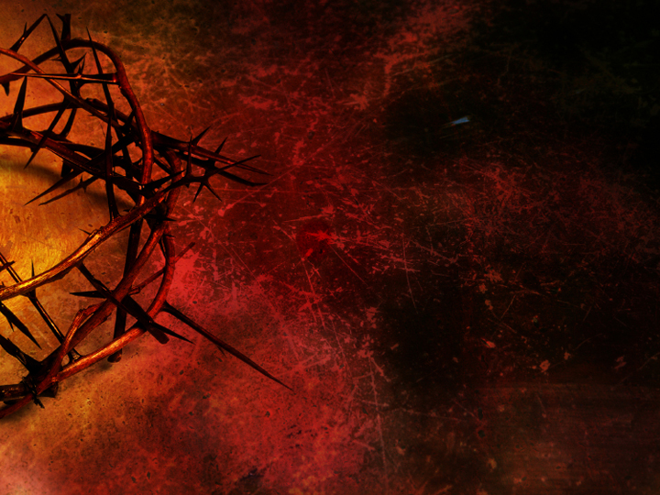
Hope is a person.
Without The Person there is no redemption of a person.

Slide 22
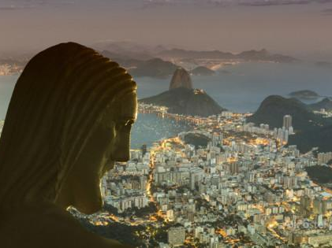
“I will take you as my own people,
and I will be your God.”
Exodus 6.7

